Slide 1
DC-Store: Eliminating Noisy Neighbor Containers using Deterministic I/O Performance and Resource Isolation
Kwon, M. et al.
2020. 01. 19
Presentation by Lee, Sounghyoun
leesh812@dankook.ac.kr

Slide 2
Introduction
DC-Store
Evaluation
Conclusion

Slide 3
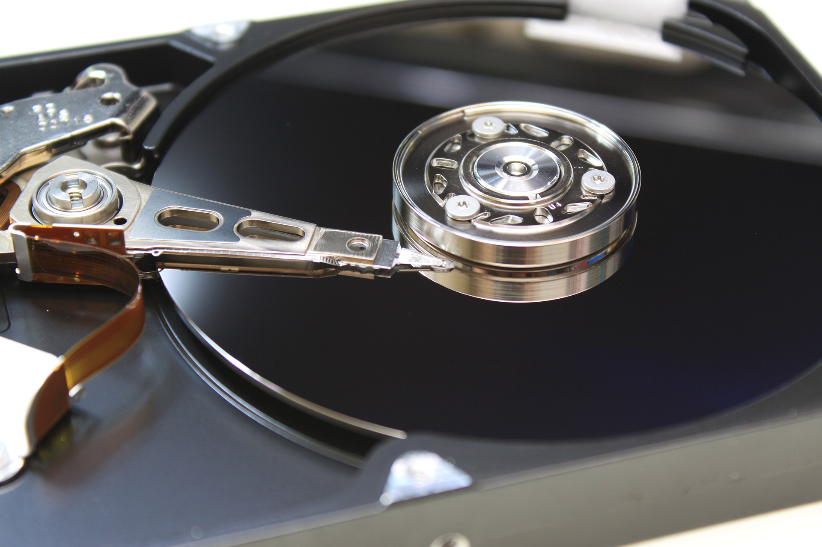
1. Introduction
Google Finance
1. Introduction
DC-Store: Eliminating Noisy Neighbor Containers using Deterministic I/O Performance and Resource Isolation

Slide 4

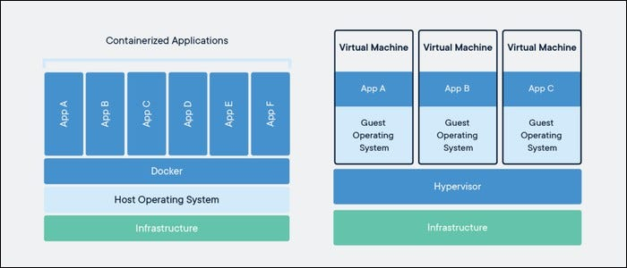
1. Introduction
Google Finance

Slide 5
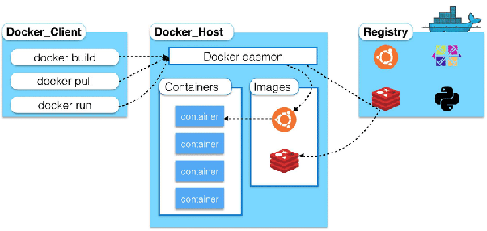
1. Introduction
Google Finance

Slide 6

1. Introduction
스토리지 관리 문제
호스트가 기본적인 SSD의 물리적 레이아웃을 인식하지 못하여 리소스 충돌 발생
스왑 영역 등의 작업으로 인해 충돌
Google Finance

Slide 7
1. Introduction
스토리지 관리 문제
호스트가 기본적인 SSD의 물리적 레이아웃을 인식하지 못하여 리소스 충돌 발생
스왑 영역 등의 작업으로 인해 충돌
Google Finance
DC-Store
+
Divided SSD
I/O Tacker

Slide 8

2. DC-Store
Google Finance
2. DC-Stroe
1. Introduction
DC-Store: Eliminating Noisy Neighbor Containers using Deterministic I/O Performance and Resource Isolation
Linux Block IO: Introducing Multi-queue SSD Access on Multi-core Systems

Slide 9
2. DC-Store
Read-intensive container
Write-intensive container
User-
Space
Kernel-
Space
Hardware

Slide 10
2. DC-Store
Read-intensive container
Write-intensive container
User-
Space
Kernel-
Space
Reads
Writes
Hardware
Reads
Writes

Slide 11
2. DC-Store
Read-intensive container
Write-intensive container
User-
Space
Kernel-
Space
Isolation
Hardware

Slide 12

2. DC-Store
Read-intensive container
Write-intensive container
User-
Space
Kernel-
Space
Reads
Writes
Isolation
Hardware
Reads
Writes

Slide 13
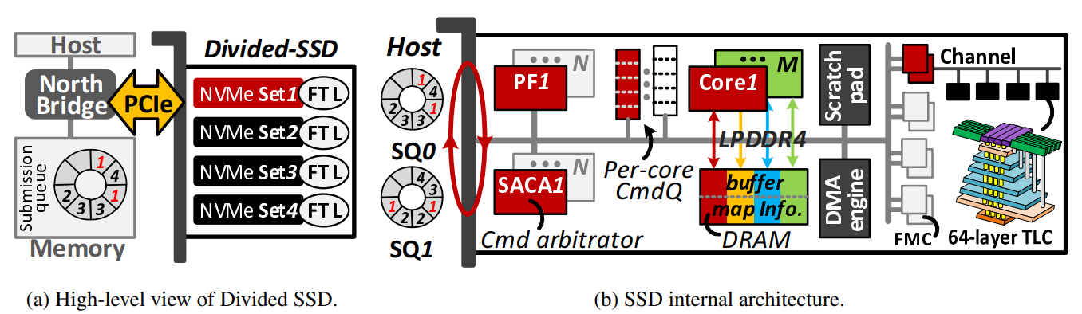
2. DC-Store
Divided SSD

Slide 14
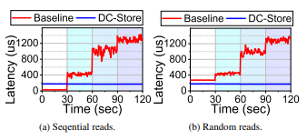
2. DC-Store
Divided SSD

Slide 15
2. DC-Store
Read-intensive container
Write-intensive container
User-
Space
Kernel-
Space
Writes
Reads
Writes
Isolation
Hardware
Reads
Writes

Slide 16
2. DC-Store
Read-intensive container
Write-intensive container
User-
Space
Kernel-
Space
Writes
Reads
Writes
Isolation
Hardware
Reads
Writes

Slide 17
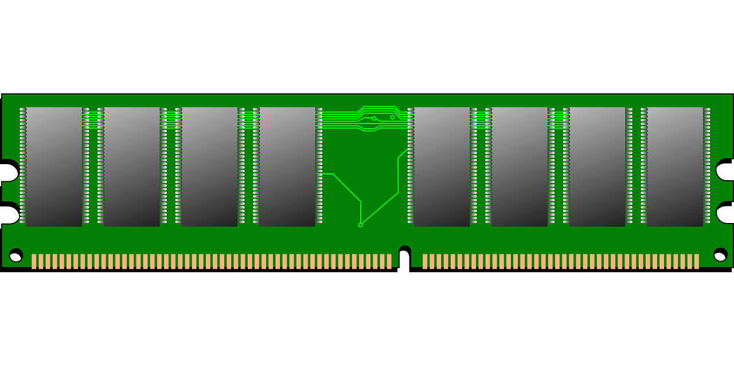
2. DC-Store
Default case
Container A’s page
frame
Container A
Container B
Container C
Container B’s page
frame
Container C’s page
frame
Swap
area
Swap
area
Swap
area
NVM Set A
NVM Set B
NVM Set C

Slide 18
2. DC-Store
Default case
Container A’s page
frame
Container A
Container B
Container C
Container B’s page
frame
Container C’s page
frame
Swap
area
Swap
area
Swap
area
NVM Set A
NVM Set B
NVM Set C

Slide 19
2. DC-Store
Round robin case
Container A’s page
frame
Container A
Container B
Container C
Container B’s page
frame
Container C’s page
frame
Swap
area
Swap
area
Swap
area
NVM Set A
NVM Set B
NVM Set C

Slide 20
2. DC-Store
Round robin case
Container A’s page
frame
Container A
Container B
Container C
Container B’s page
frame
Container C’s page
frame
Swap
area
Swap
area
Swap
area
NVM Set A
NVM Set B
NVM Set C

Slide 21
2. DC-Store
pinnable
flag
Swap
area
+
pinnable
flag
NVM Set A

Slide 22
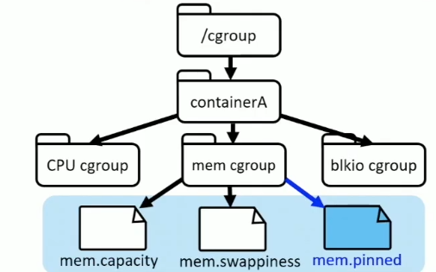
2. DC-Store
Read-intensive container
pinnable
flag
Swap
area
+
META DATA
=
NVM Set A
pinnable
flag
NVM Set A

Slide 23
2. DC-Store
Read-intensive container
pinnable
flag
Swap
area
+
META DATA
=
NVM Set A
pinnable
flag
NVM Set A
+
Page 1
mem_cgroup
pointer
Page 2

Slide 24
2. DC-Store
Read-intensive container
pinnable
flag
Swap
area
+
META DATA
=
NVM Set A
pinnable
flag
NVM Set A
Container A’s
cgroup
+
Page 1
mem_cgroup
pointer
META DATA
=
NVM Set A
Page 2

Slide 25
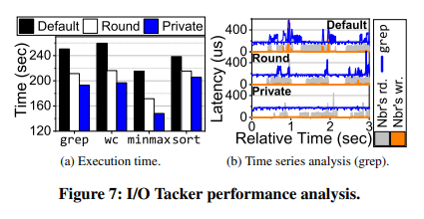
2. DC-Store
I/O Tacker performance

Slide 26
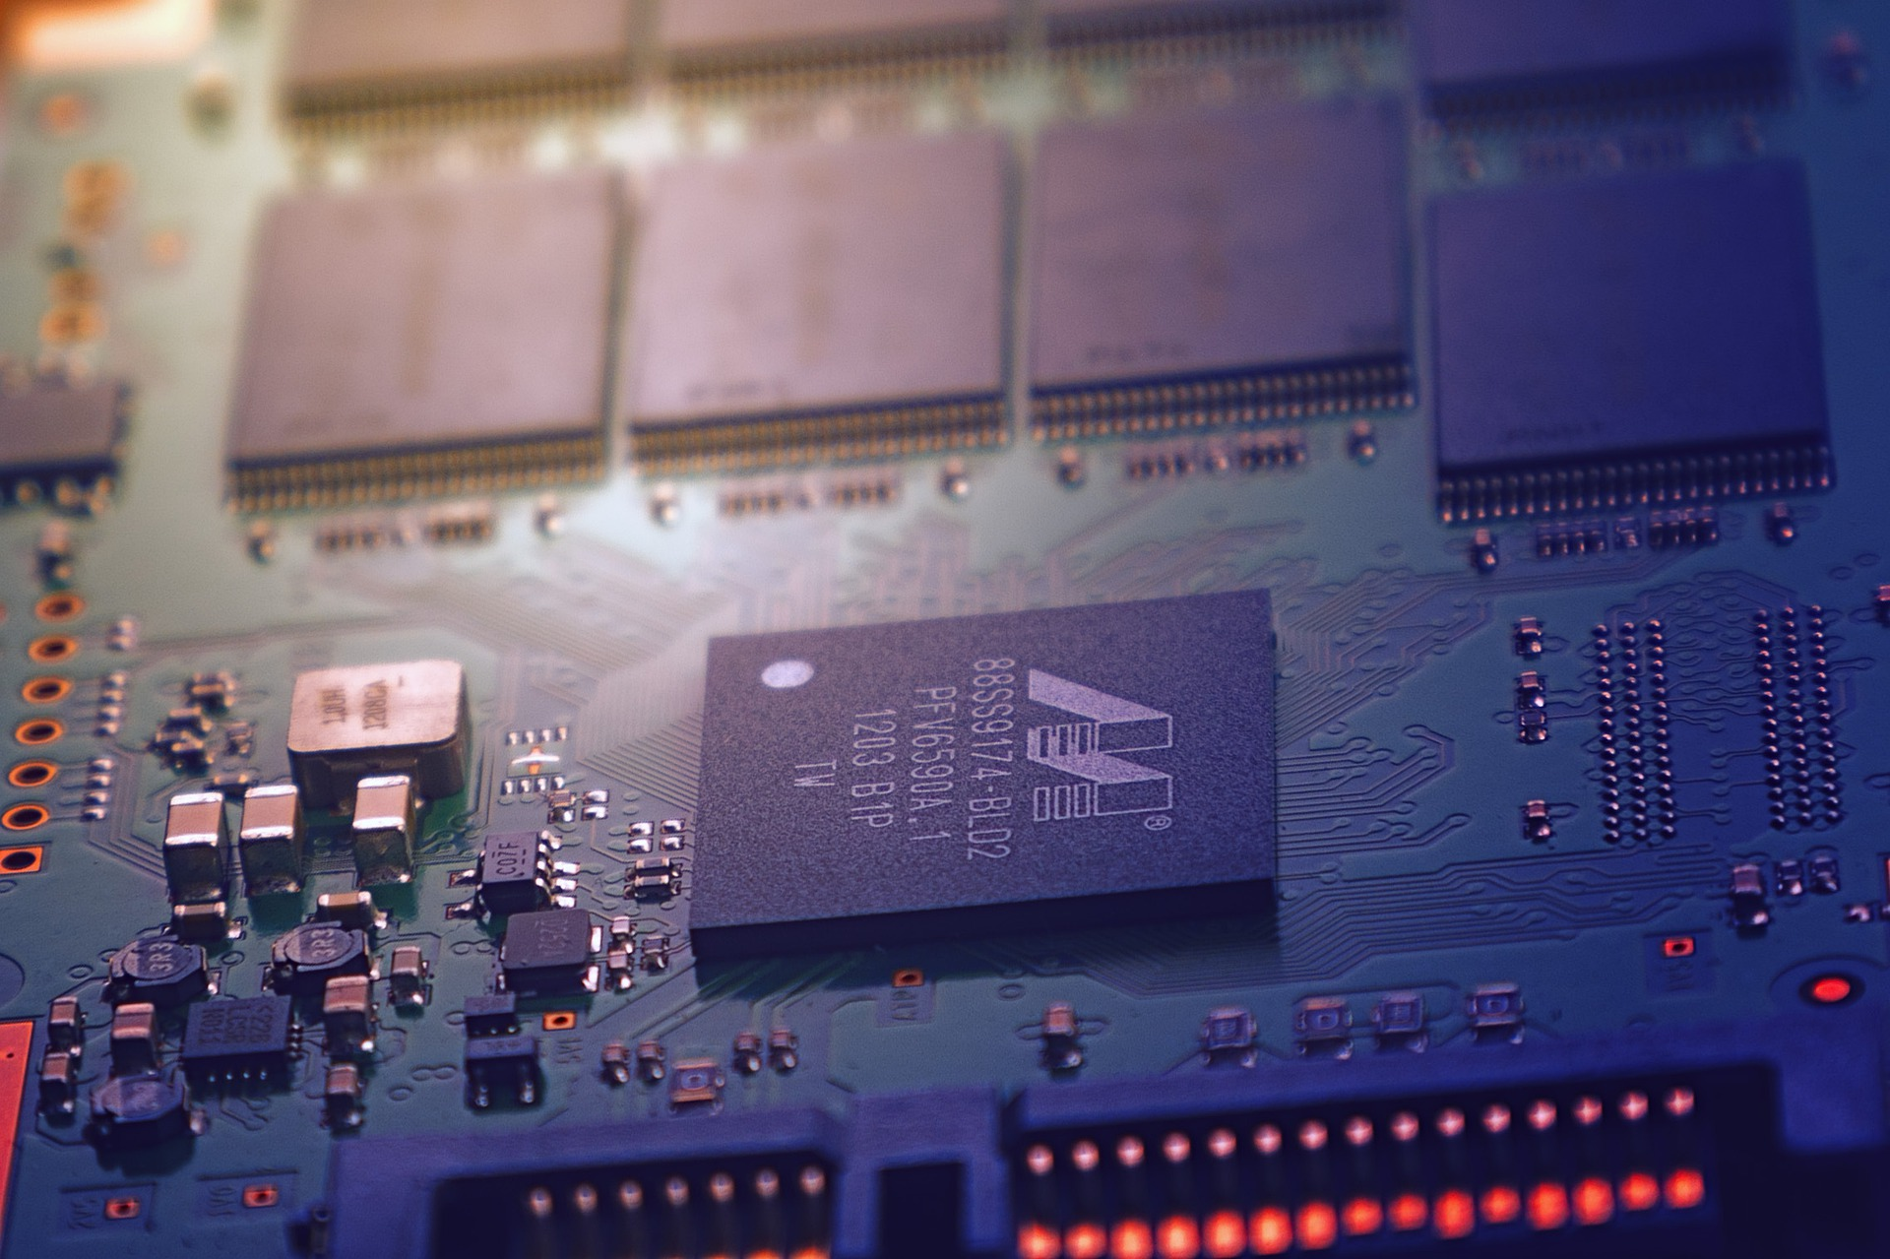
3. Analysis and Results
3. Evaluation
DC-Store: Eliminating Noisy Neighbor Containers using Deterministic I/O Performance and Resource Isolation

Slide 27
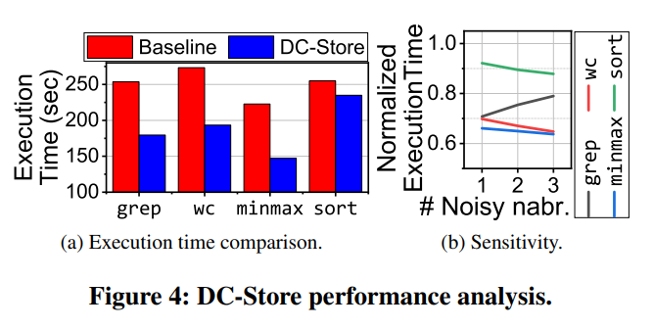
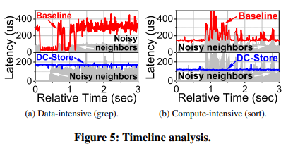
3. Evaluation
Evaluation

Slide 28

4. Conclusion
4. Conclusion
DC-Store: Eliminating Noisy Neighbor Containers using Deterministic I/O Performance and Resource Isolation

Slide 29
4. Conclusion
Conclusion
- 현재 Docker는 SSD의 물리적 구조를 이해하지 못하기때문에 문제가 발생함.
- Divided SSD와 I/O Tacker를 이용하여 문제를 해결 할 수있는 DC-Store를 개발함.
- Divided SSD의 경우 하드웨어에서 NVMe Set을 나누어 구현함.
- I/O Tacker의 경우 Cgroup과 페이지, 스왑 영역을 수정하여 구현함.
- 이를 통해 sort의 경우 7%, grep, wc, minmax의 경우 약 31%의 성능을 개선함
Google Finance

Slide 30
DC-Store: Eliminating Noisy Neighbor Containers using Deterministic I/O Performance and Resource Isolation
Kwon, M. et al.
Thank you!
2020. 01. 19
Presentation by Lee, Sounghyoun
leesh812@dankook.ac.kr

